Slide 1
YI IDS 4-GREENOVATION CHALLENGE PHASE SHARE SUBMISSION
TITLE: CoolEarth A Holistic Approach to Sustainable Urban Cooling
BY: TEAM PHOENIX !
Challenge: Low cost cooling solutions for warming cities !

Slide 2
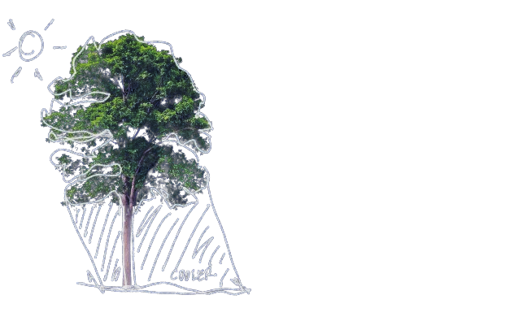
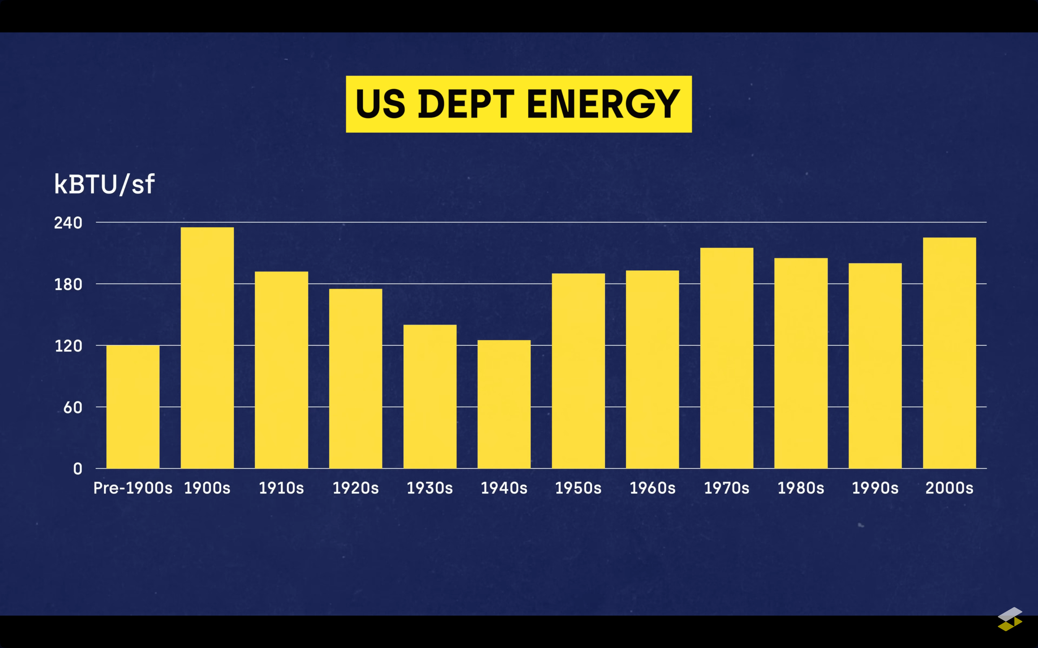

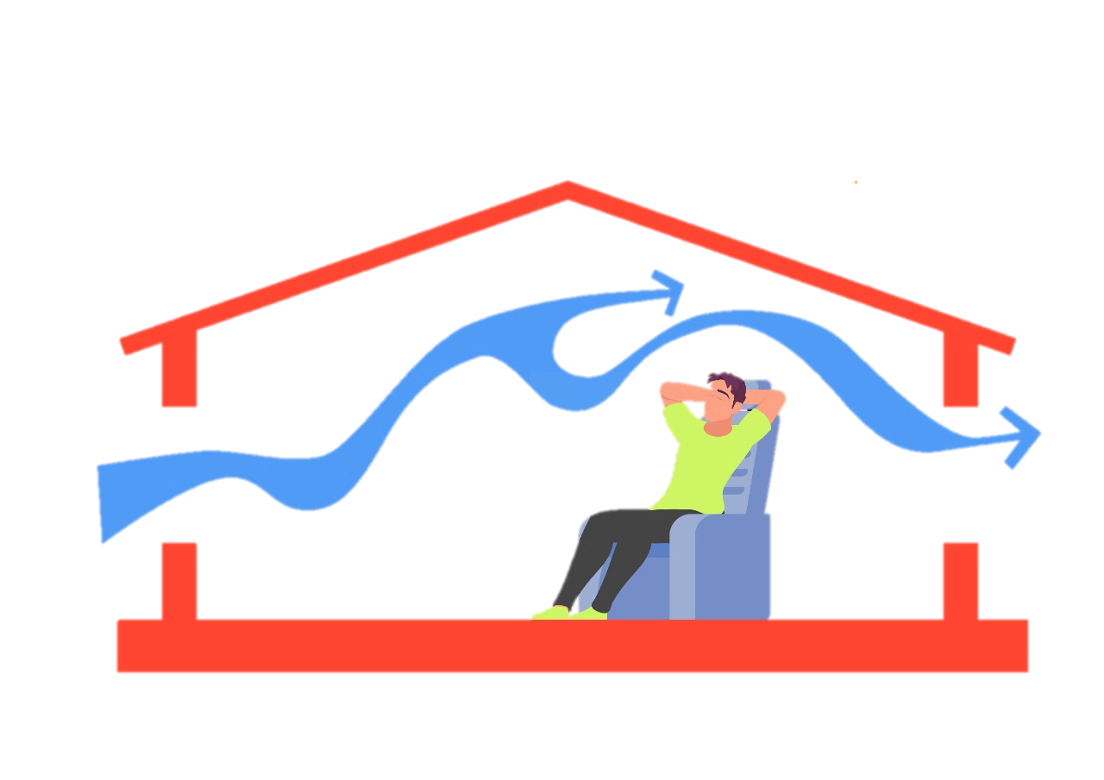
ISSUE TO BE RESOLVED:
PRODUCTION OF TOXICANTS AND CARBON COMPOUNDS
EXTREME POWER AND LOAD CONSUMPTION
GLOBAL WARMING AND TEMPRATURE RISING
Environmental and Health Concerns Via (HCFCs) and chlorofluorocarbons (CFCs)
Increased power use leads to higher electricity bills and strains on servers, networks, and power grids.
The environmental damage caused by increased production cannot be easily mitigated, leading to significant carbon footprints.
INCREASING COSTS AND LIMITED AVAILABILITY
INCREASED DEMAND OF INDIVIDUAL CHILLERS AND ACs
EXCESSIVE USAGE REQUIRES MORE MAINTENANCE
Air conditioning and other cooling devices are becoming more expensive to use, especially in urban areas.
High demand for cooling devices results in shortages, prompting increased production and carbon emissions.
Frequent usage necessitate excessive maintenance, exacerbating system reliability issues.
Facts are collected from different research papers, news, data on internet, and market research etc

Slide 3
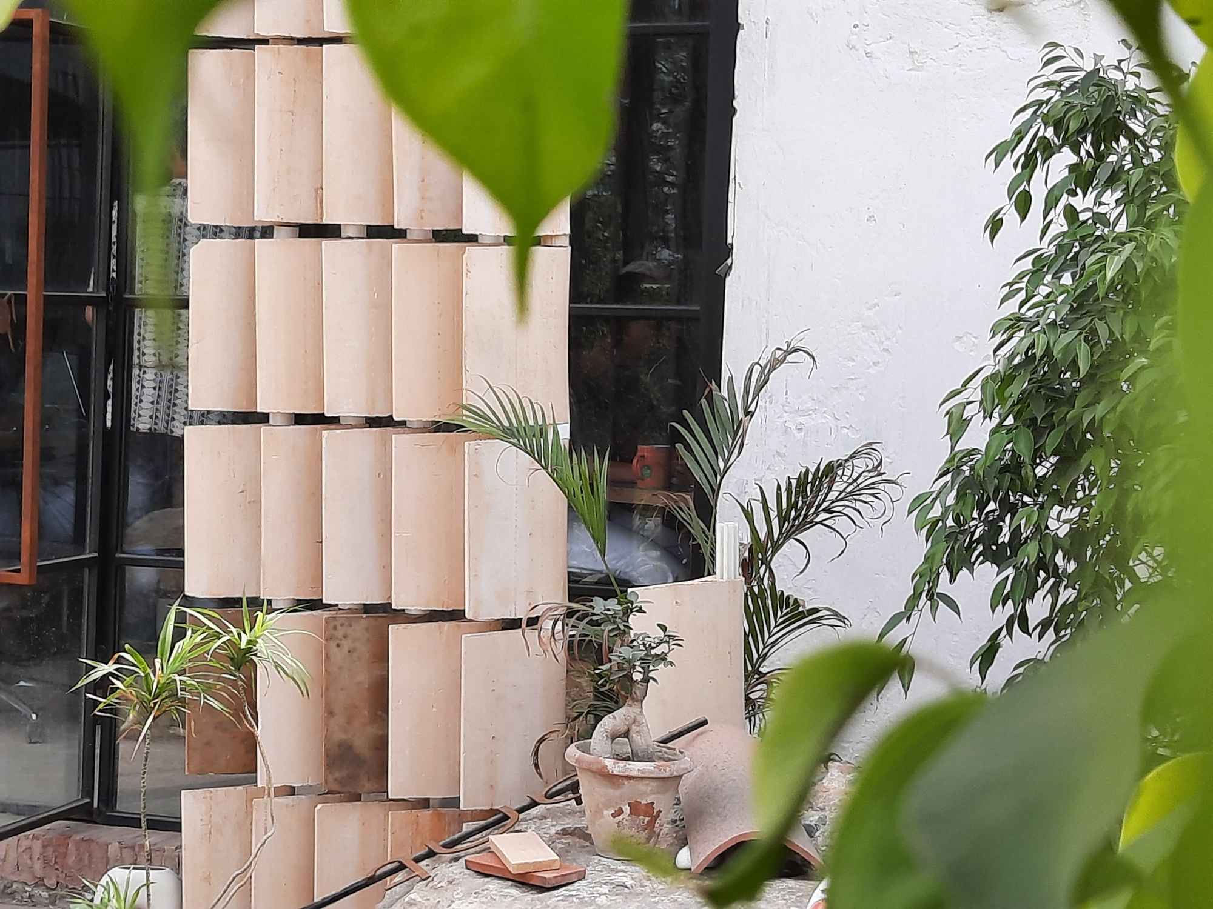
Presenting CoolEarth For Sustainable Cooling.
CoolEarth An urban cooling solution using subterranean pipes for energy-efficient cooling, inspired by ancient Indian methods. Supports carbon neutrality goals and local economies with sustainable materials and expertise.
Objectives:
Reduces energy consumption and associated costs while utilizing natural materials for evaporative cooling.
Minimizes carbon emissions and environmental impact, providing a scalable solution for urban areas.
Easily integrated into existing structures without significant technical expertise required, and can be outsourced effortlessly.
Manufactured with durable materials, requiring minimal additional application and maintenance, and can be utilized with obsolete technologies for extended periods across various environments with little modification needed.
Facts are collected from different research papers, news, data on internet, and market research etc
DEVICES | CARBON EMMITION | TEMPRATURE
Cool Earth | 0.01 Gm/day | 20-40% drop constant and significant

Slide 4

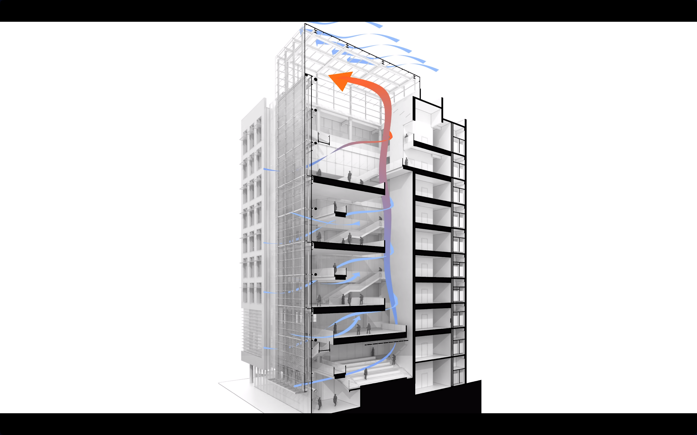
Feature Of Sustainable Cooling System.
Lower operational costs by reducing energy use.
Design Aesthetics
Easy Integration
Giving Structure Modern design with stunning looks.
Designed to work with existing structures without major modifications.
Cost-effective
Targeted User
Lower operational costs by reducing energy use.
Both commercial and residential buildings in metropolitan areas.
Easy Availability
Upgradability
Straightforward and designed to be easily transported and manufactured anywhere.
Can be enhanced with further research and market opportunities.
Facts Are Collected From Different Research Papers, News, Data On Internet, And Market Research Etc

Slide 5
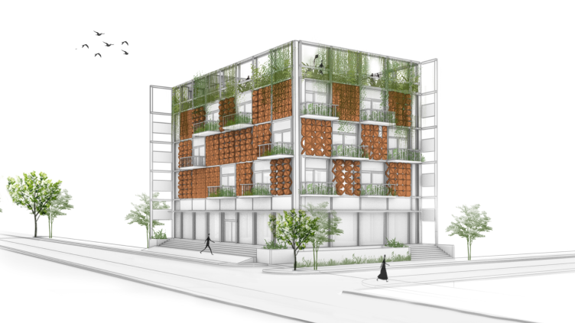
COOLEARTH’s BREAKDOWN DETAILS
SUB PARTS | WORKING OBJECTIVE | ELECTRICITY CONSUMPTIONS | WORKING COST | CARBON EMMITION | TEMPRATURE REDUCTION
LETTERITE LOUVERS | Louvres improve cooling by increasing airflow and evaporation, while cool water flows inside to regulate basic ventilation and cooling. | N/A | N/A | 0.01 Gm Per Day | 20-40% drop constantly and significantly for longer period
GEOTHERMAL COOLING | Uses the earth's consistent subsurface temperature to efficiently cool buildings via a network of subterranean pipes and heat exchange fluids. | 4-6 UNITS/DAY | Rs.60-80/DAY
PHASE CHANGING MATERIAL (PCM) | Absorbs heat during the day, transitioning from solid to liquid, and releases stored heat at night by returning to the solid state, thereby maintaining temperature equilibrium. | N/A | N/A
DESIGN AND ARCHITECTURE | Buildings and spaces are constructed to allow hot air to escape and cold air to enter through louvres, therefore optimising ventilation and improving indoor cooling effectiveness. | N/A | N/A
Key Points:
Utilizes natural elements for cooling, reducing reliance on energy-intensive systems.
Operates efficiently with minimal environmental impact, leveraging subsurface temperature and natural winds.
Promotes sustainability through local materials, contributing to India's carbon neutrality goal.
Facts are collected from different research papers, news, data on internet, and market research etc
THE YEARLY SAVINGS OF 1 ACARE SPACE INTEGRATED WITH COOLEARTH
Can Reduce Temperature :
SAVE UPTO 20000Kw energy/year
SAVE UPTO 204280l water/year
From: 30-27°C
(avg in bpl)
SAVE UPTO 70-80% of bill
LIFE CYCLE UPTO 100 Years
To: 20-24°C
(Constantly)

Slide 6
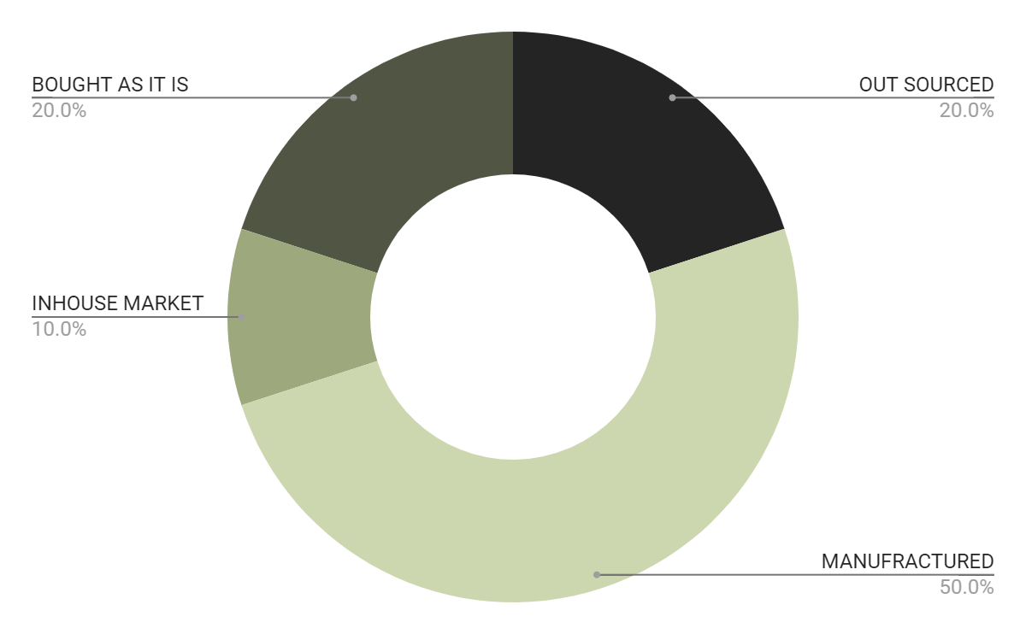
THE MATERIAL SPLIT AND OUTSOURCING
MANUFRACTURING
Most Of The Material Is Made In House, Made In India On Order And Customized Accordingly
OUTSOURCING
20% Of Materials Are Either Patented Or Manufactured By Other Companies.
OUTSOURCED
OUTSOURCED
INHOUSE/ONORDER
PRESSURE PUMP
PHASE CHANING MATERAL SHEETS
INSULATOR PIPES
INHOUSE/ONORDER
INHOUSE/ONORDER
INHOUSE/ONORDER
INHOUSE/ONORDER
GRID/WEB OF PIPES
INSULATING PIPES
HOLLOW/NORMAL LOUVERS
METAL FRAME AND CONNECTOR
Facts are collected from different research papers, news, data on internet, and market research etc
GEOTHERMAL SYSTEM
PCM SHEETS AND MATERIAL
LATERITE CLAY LOUVERS
WORKING SYSTEM

Slide 7
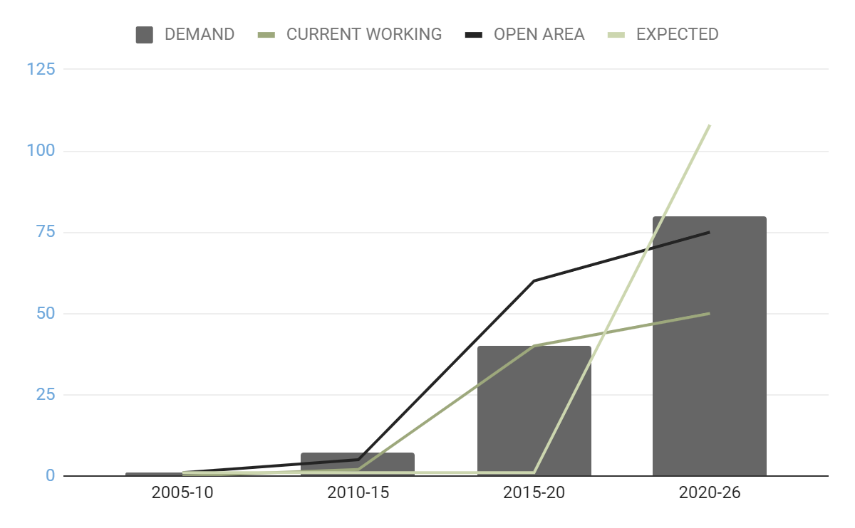
MARKET SIZE OVERVIEW
Expected Market Growth
$10.8B
Include the overall market size, which reflects the complete possible client base for the product or service.
For the next 3–5 years.
$7.5B
$5B
Ready To Enter Market
Determine the target market for the product or service, which may be a subset of the larger market. This is based on demographics, location, or special needs and may be caught if accomplished correctly.
Currently Fulfilled Market
Facts are collected from different research papers, news, data on internet, and market research etc
Indicates the current market size, which is the proportion of fulfilled demand in the target market that the companies has effectively acquired.

Slide 8
COMPETITION COMPARISON
 | BASED | PRODUCT | PRICINGS | OPERATIONAL IN INDIA | IMPACT ON ENVAROMENT | RELIABILITY
Urban Cooling | FARMING | ROOF TOP PLANTS AND DESIGNS | Rs.2,50,000+ | YES | LOW | 10%-30%
ENGIE | SOLAR & WIND | SOLAR FARMING AND WIND PROJECTS | Rs. 1,70,000+ | NO | MODERATE | 50-60%
The Urban Greening | FARMING | GREEN FARMING ON SURFACES OF BUILDING | Rs. 2,55,000+ | NO | MODERATE | 10%-30%
Cooling ToolBox | SHADES AND COMPRESERS | CUSTOMIZE SHADES AND SHAPE DEVLOPMENT | Rs. 1,70,000+ | NO | LOW | 30%-50%
AWLV | SOLAR, SHADES & VENTILATION | SOLAR SHADES, VENTILATION DESIGNS | Rs. 2,00,000+ | YES | MODERATE | 40%-60%
CoolEarth | Geothermal, PCM, louvers, designing | COMBINATION OF THREE SEPARATE APPROACHES TO EFFECTIVELY COOL THE SURROUNDINGS OF THE FITTED SPACE. | Rs. 1,00,000+ | YES | VERY LOW | 90-95%
GIBSS | GEO COOLING | GEOTHERMAL COOLING | Rs. 5,00,000+ | YES | MODERATE | 75%-95%
Facts are collected from different research papers, news, data on internet, and market research etc

Slide 9
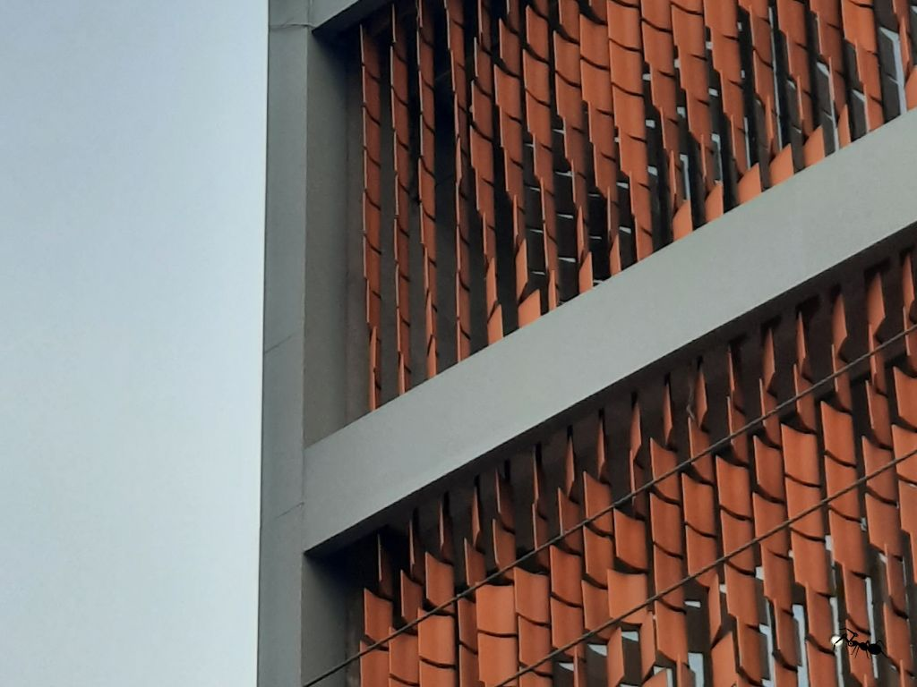
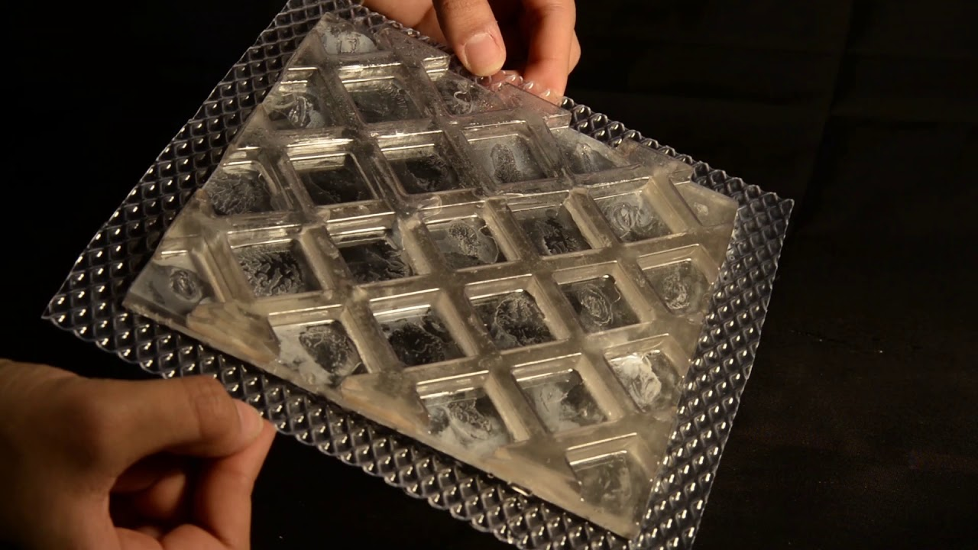
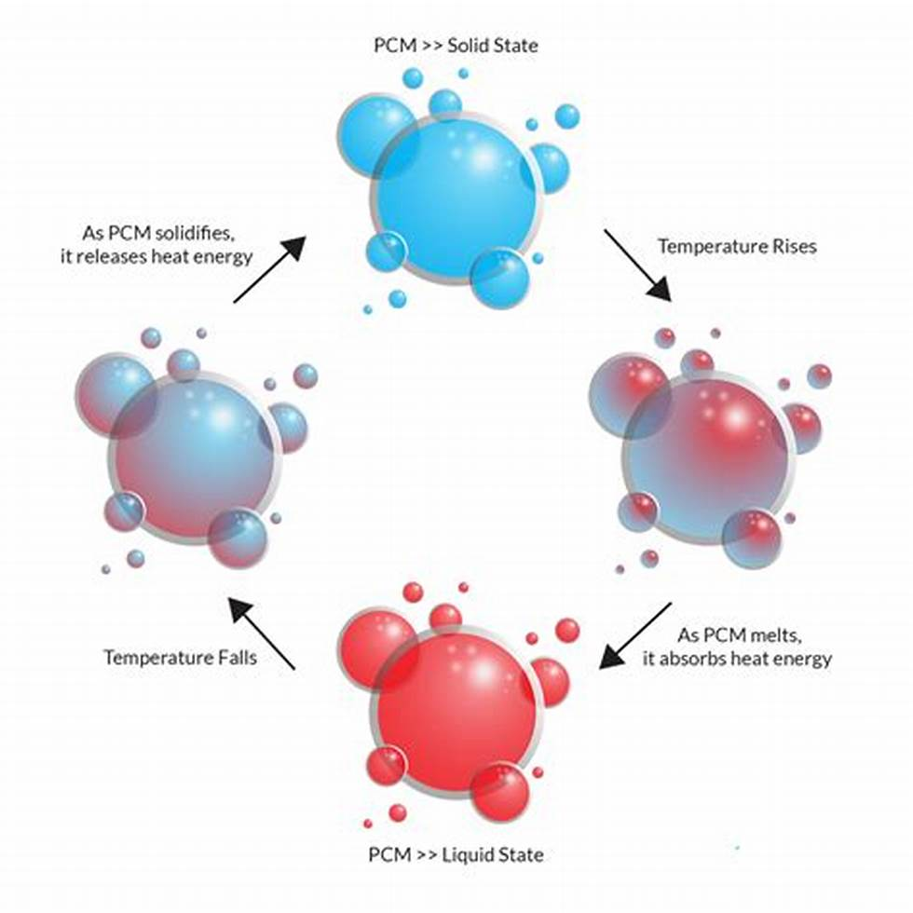
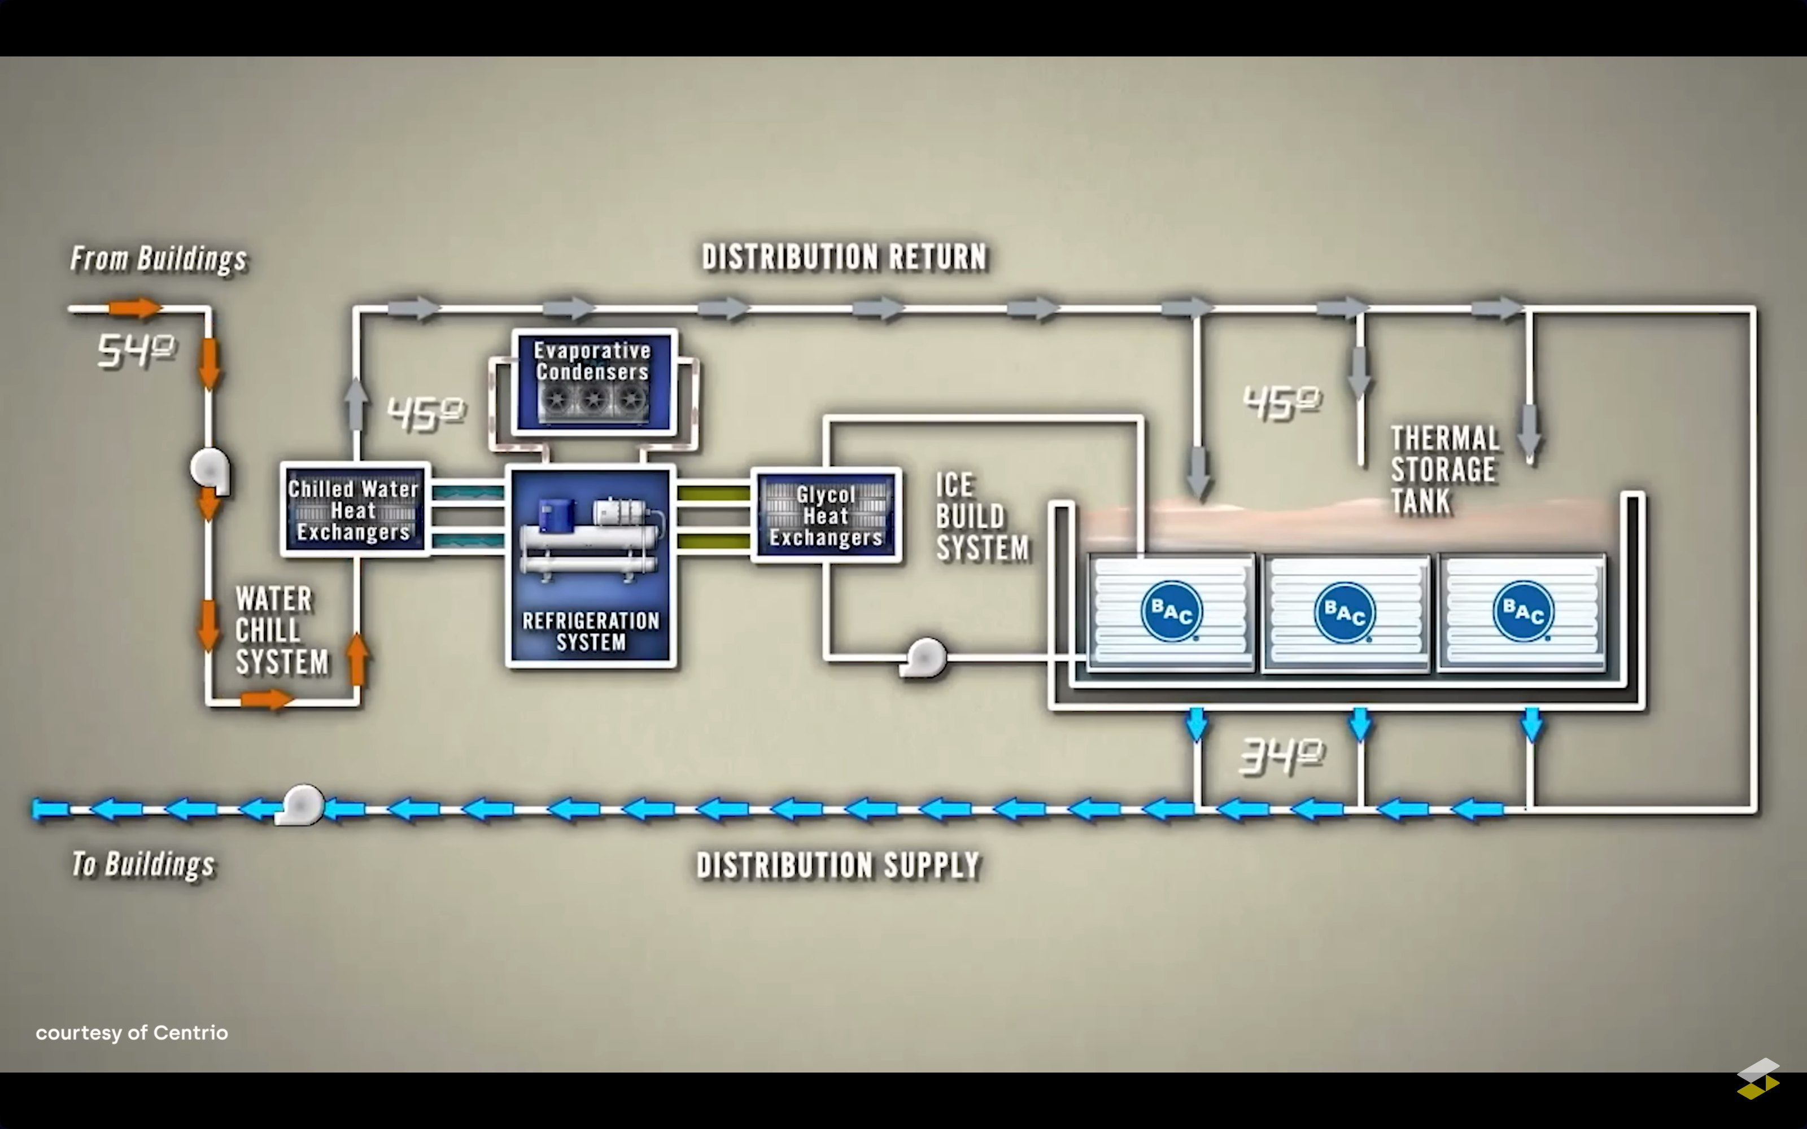
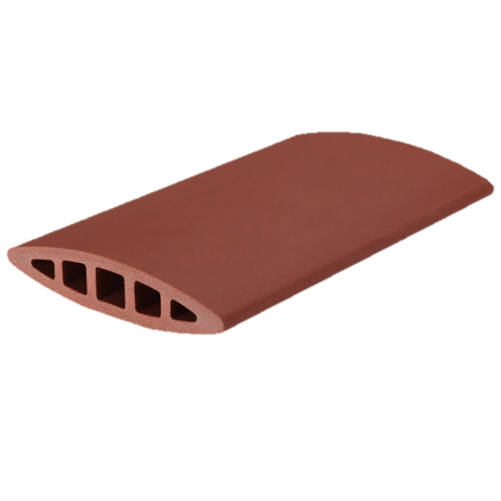
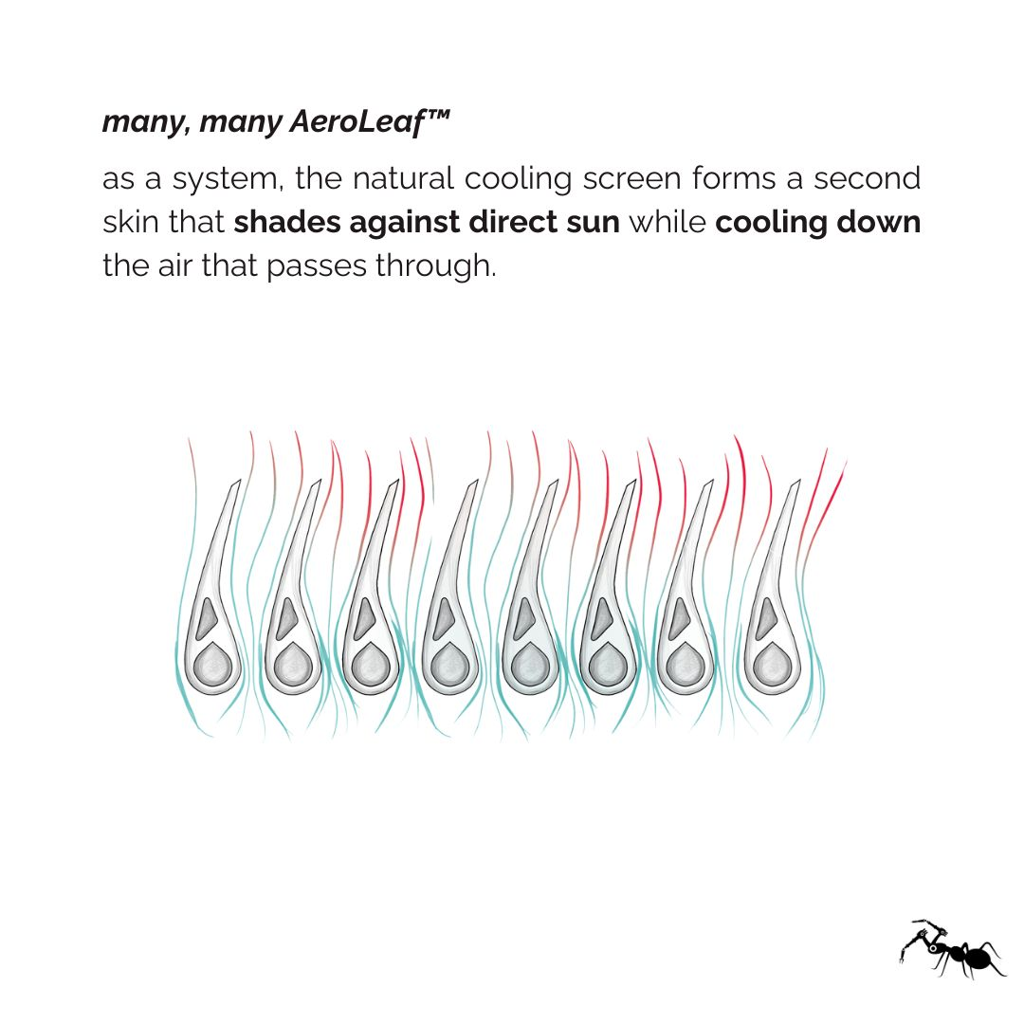
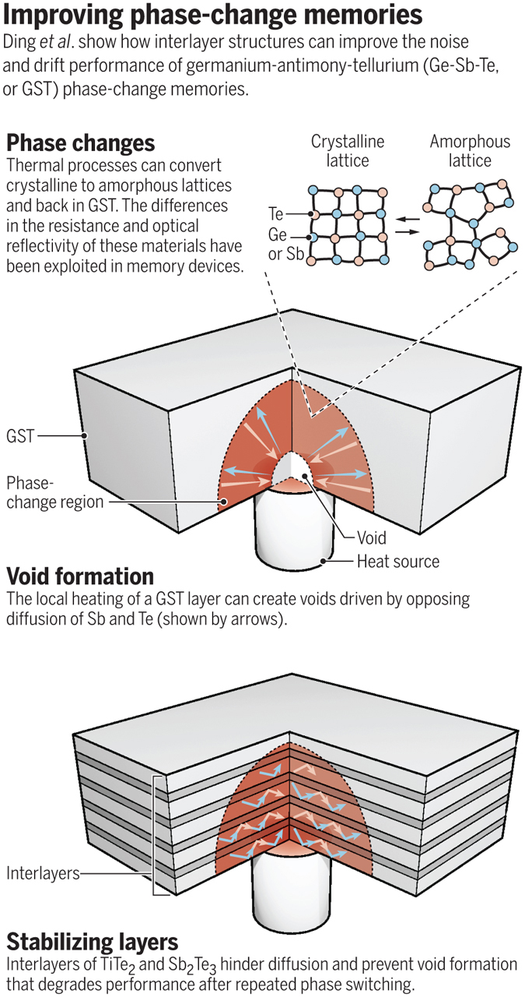
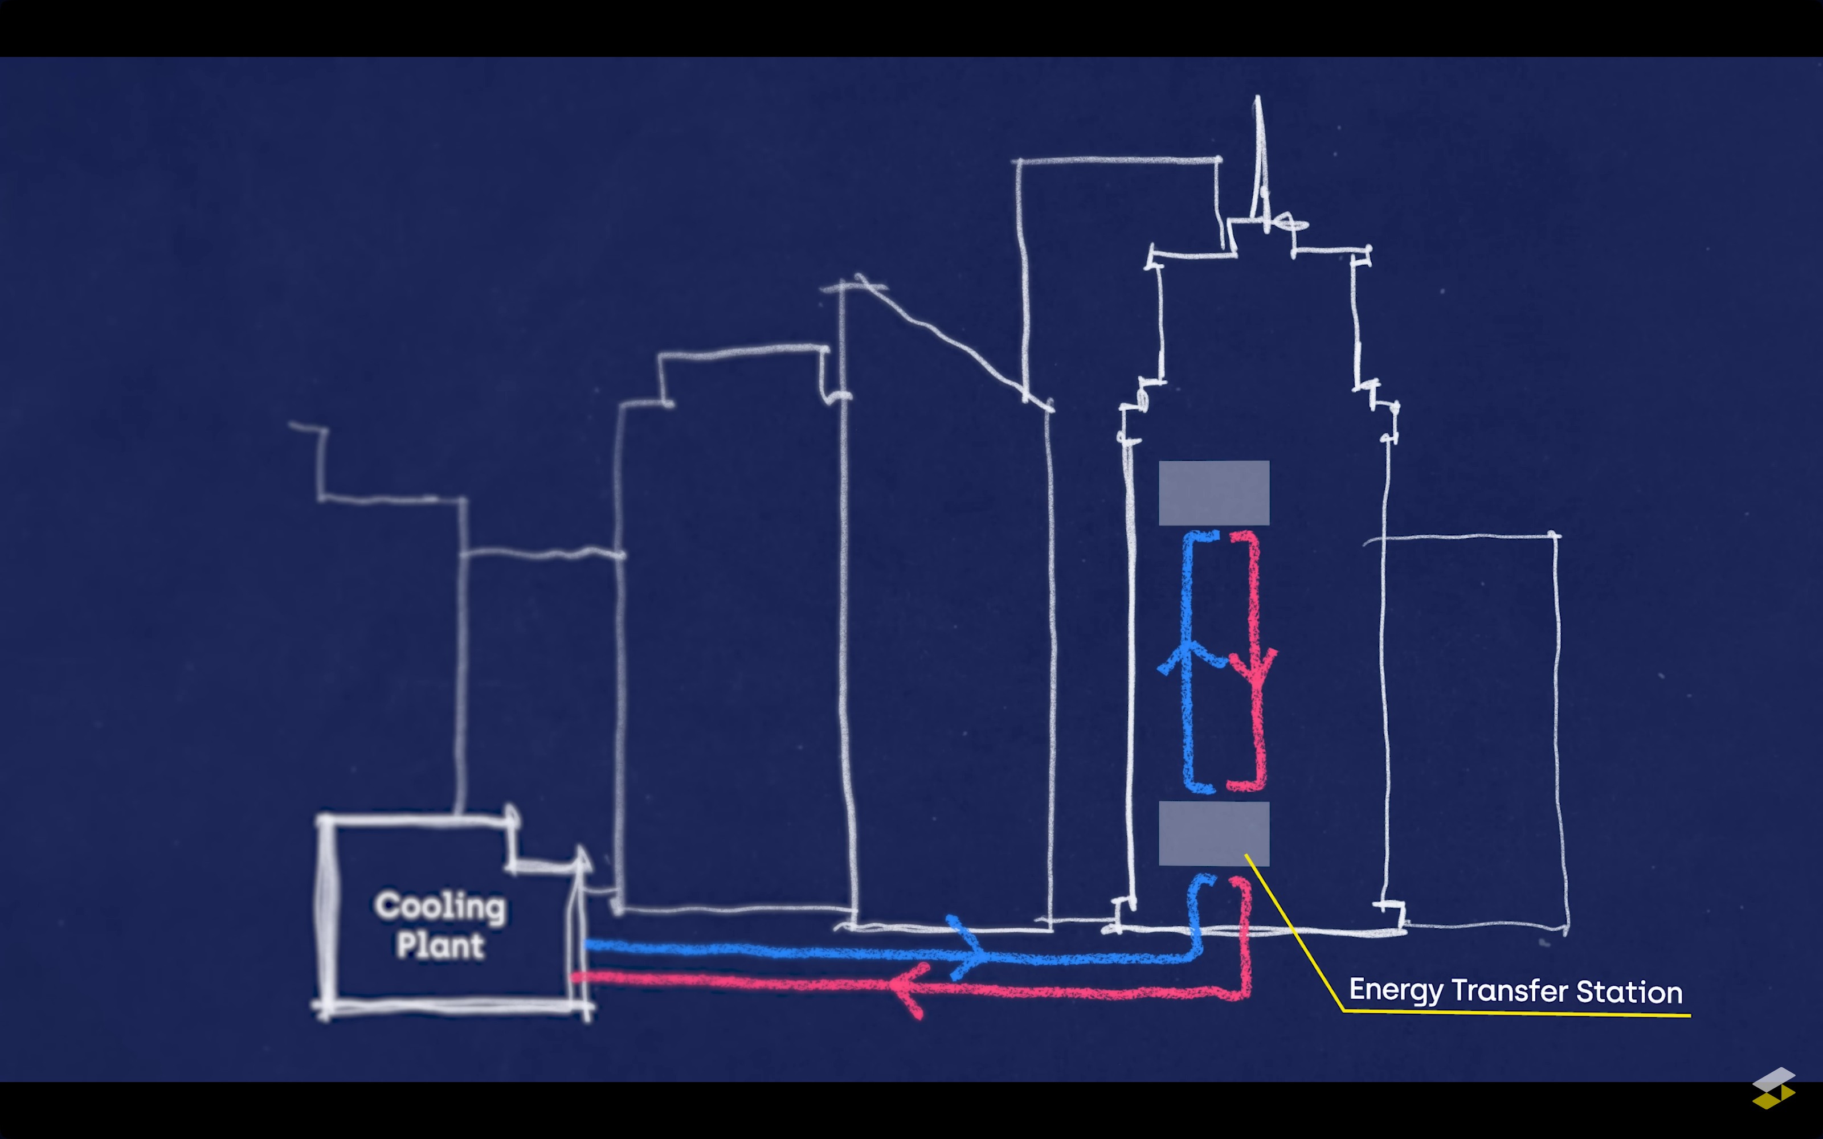
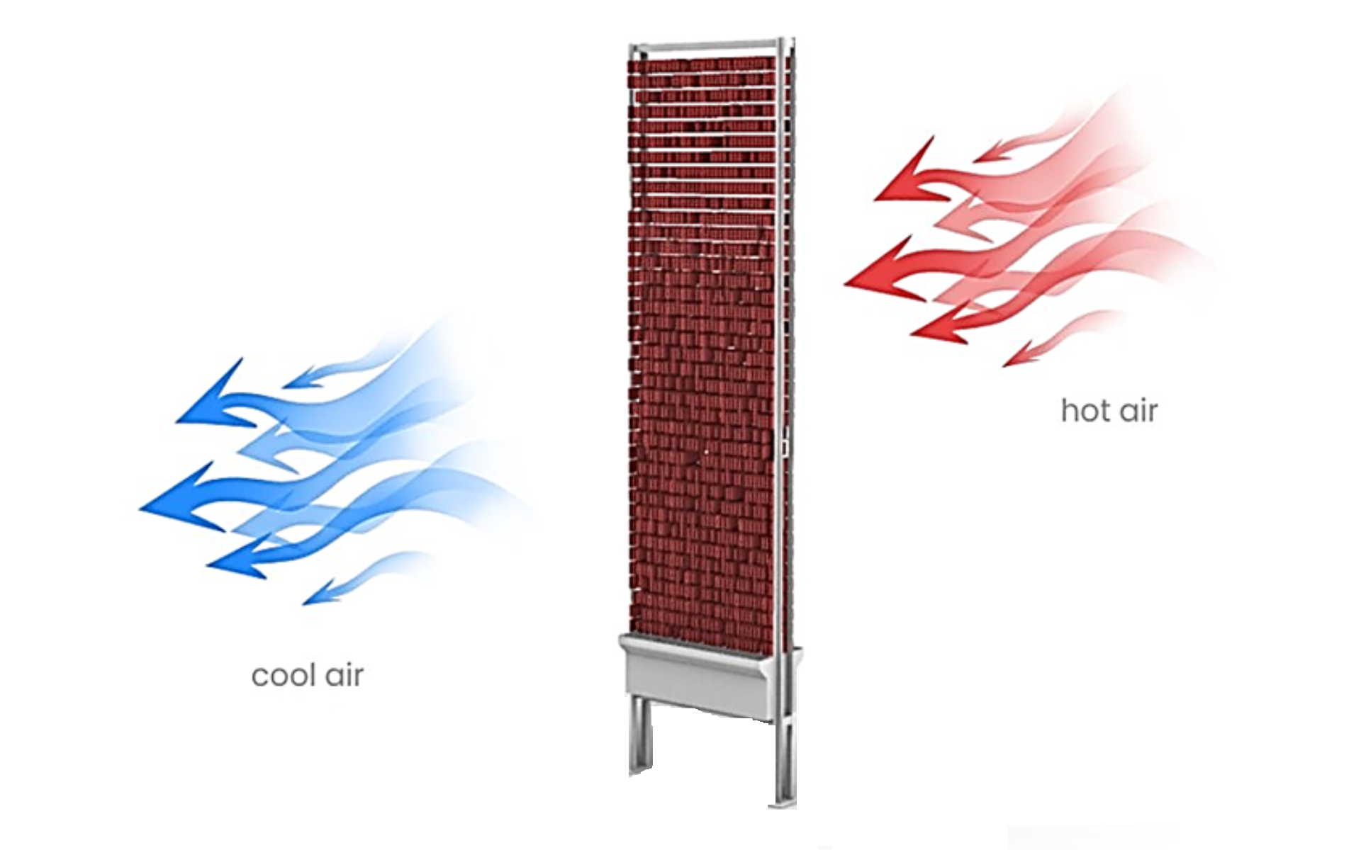
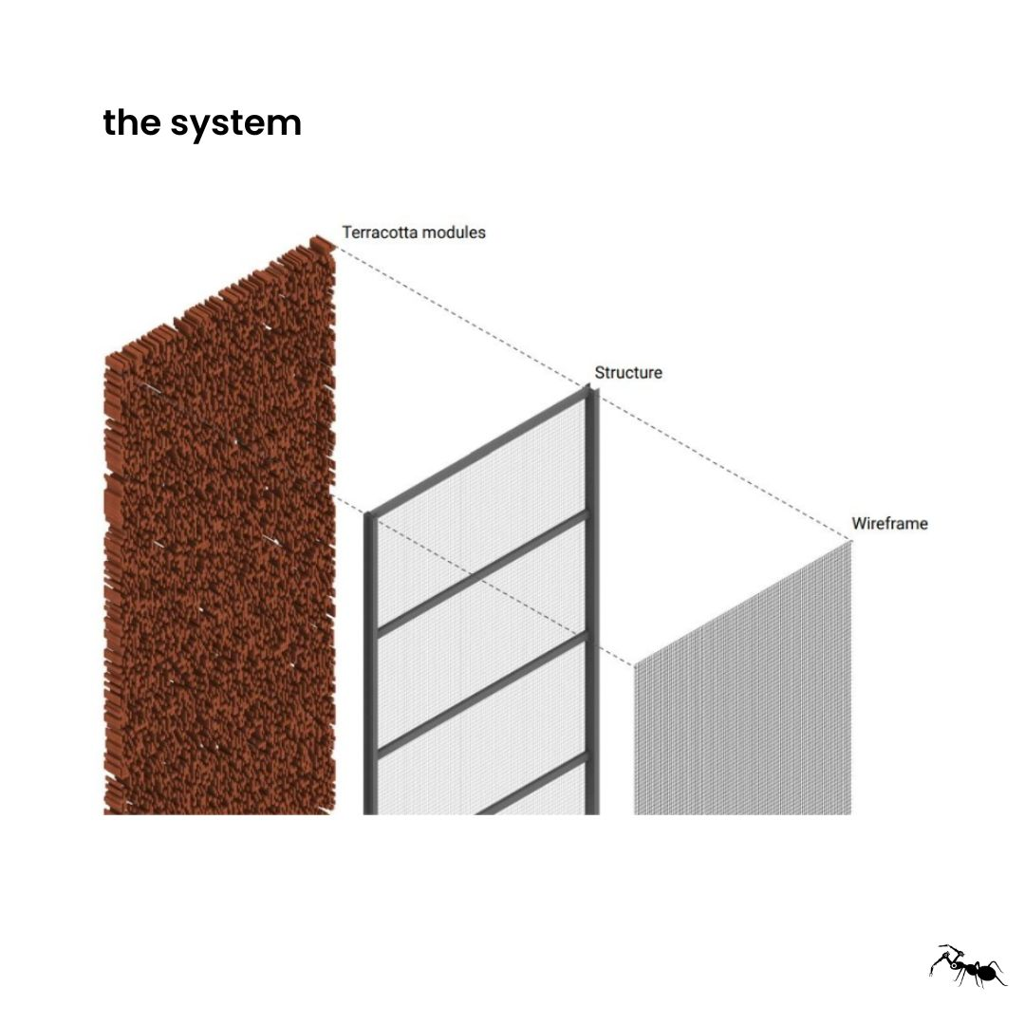
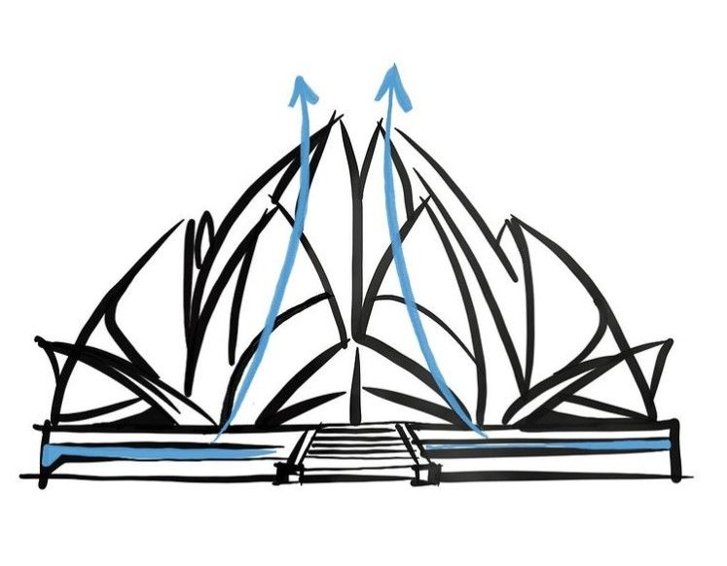
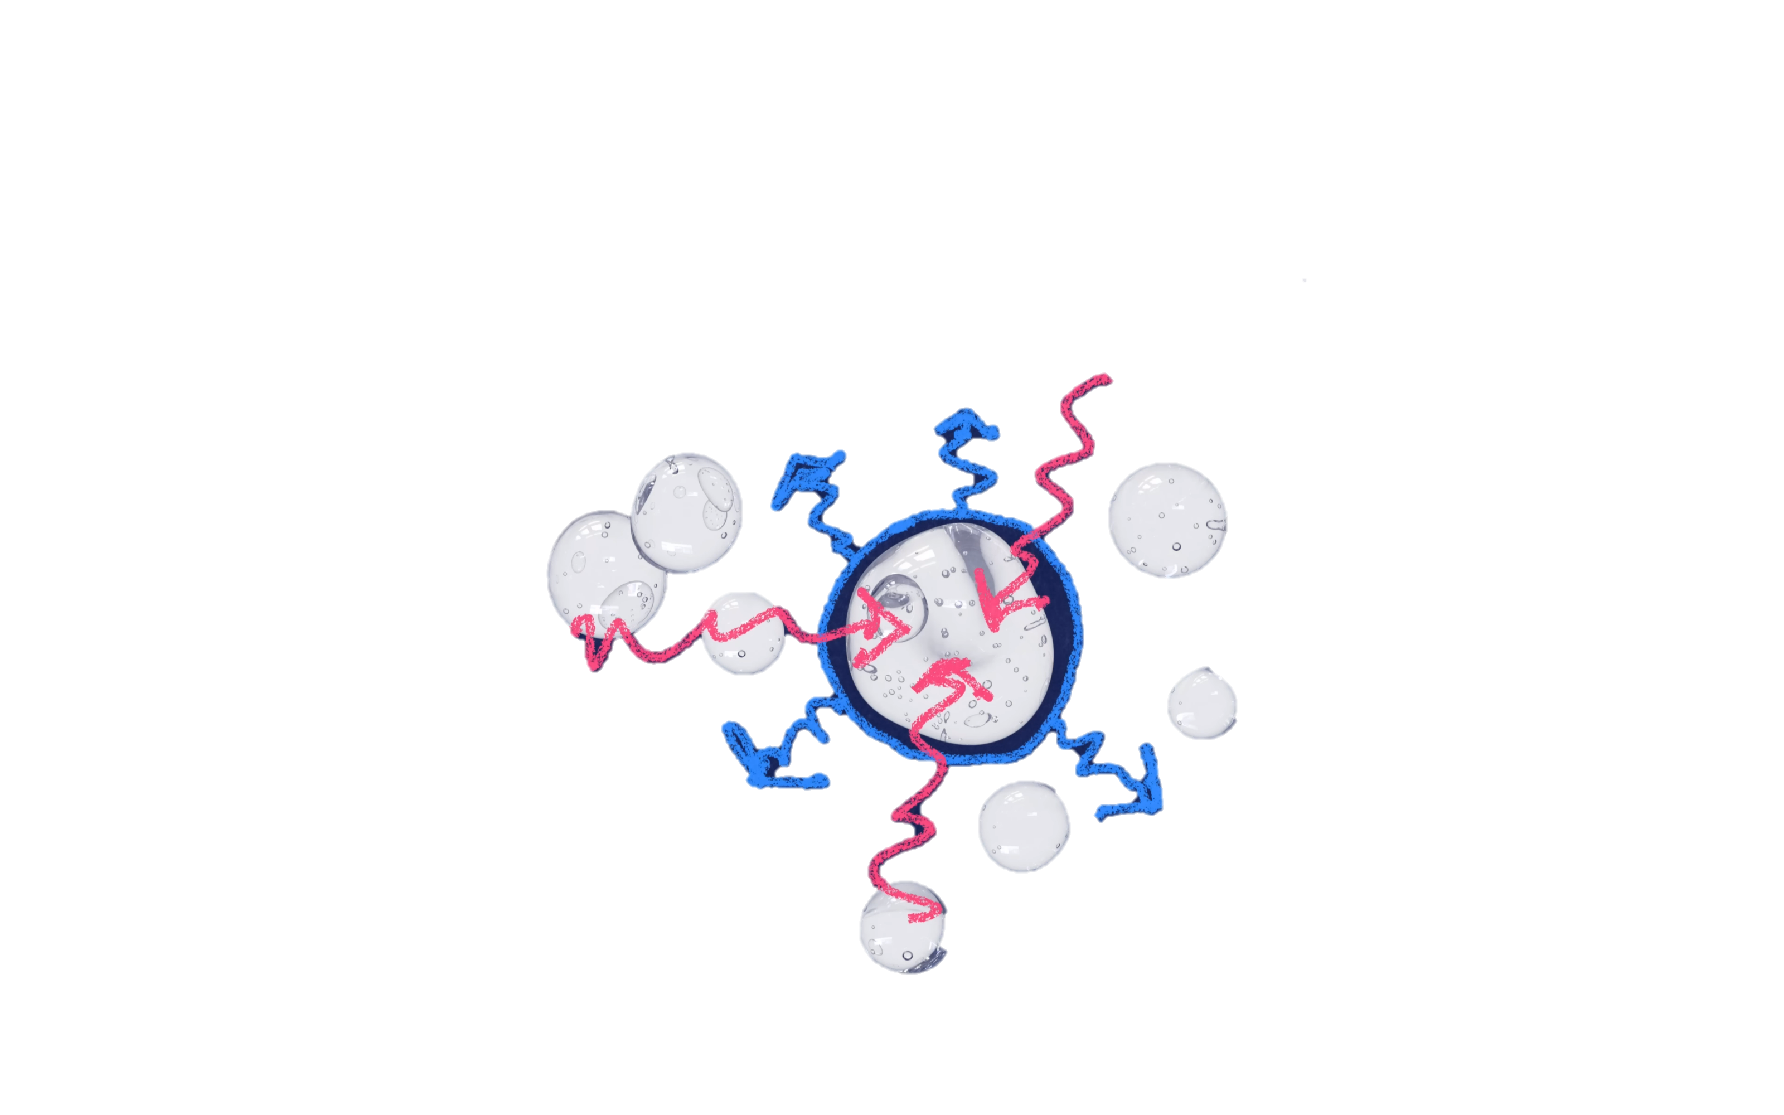
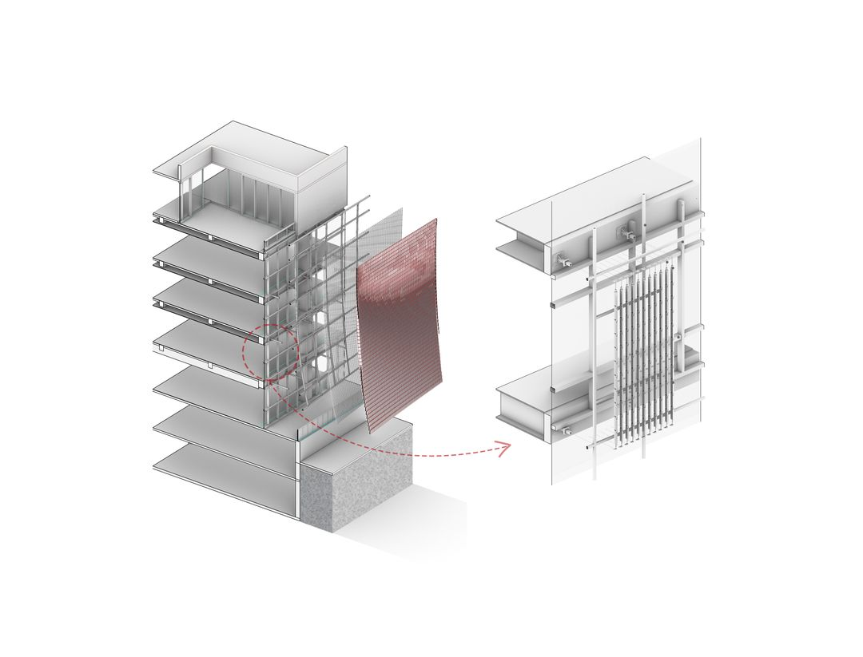
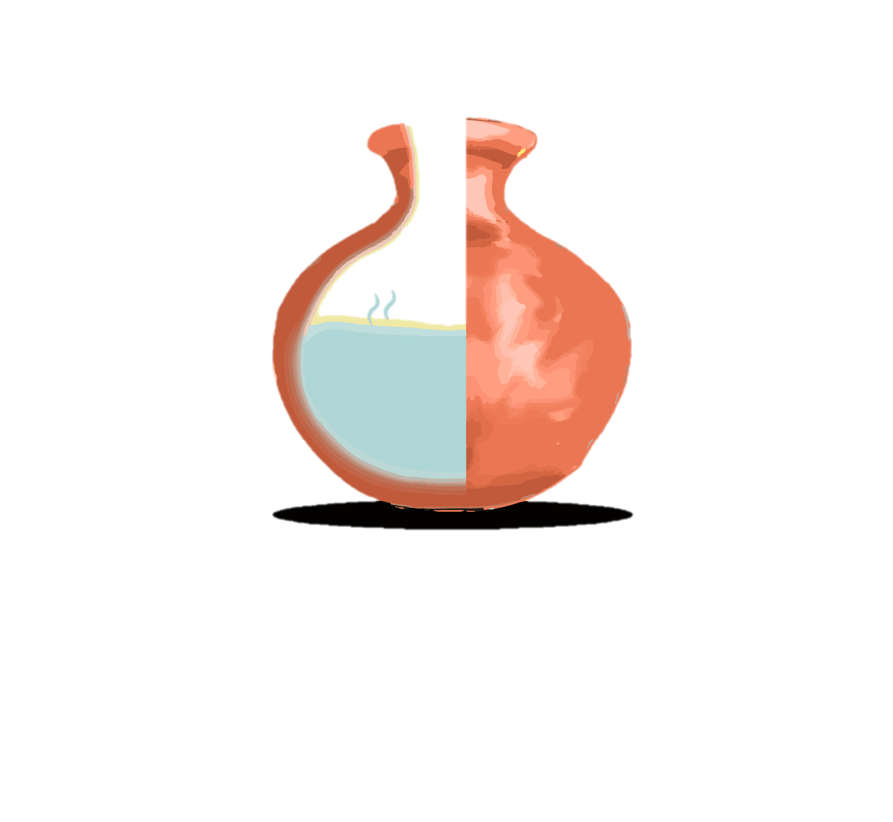
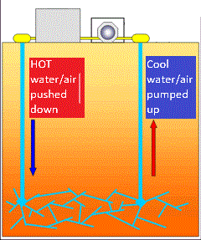
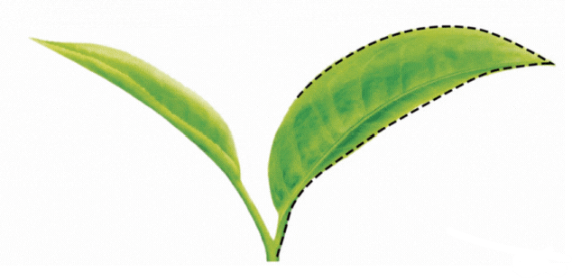
MAIN ELEMENTS AND RELATED PICTURE
TERRACOTTA & LATERITE LOUVERS
PCM SHEETS AND MATERIAL
GEOTHERMAL COOLING
DESIGN AND ARCHITECTURE
Facts are collected from different research papers, news, data on internet, and market research etc

Slide 10




IMPLEMENTATION PROCESS
Assembling The Pre-designed System Components On-site As Needed
Integrating The Components And Positioning Them According To The Structure
Testing The Combined Operation And Airflow, And Checking For Errors
Finally Evaluating The Potential Performance And Energy Efficiency Of The Setup
1. Assessment and Planning
2. Material Procurement
3. Integration with Existing Systems
Conduct a thorough assessment of the building's current cooling system and structure.
Develop a detailed implementation plan tailored to the specific needs of the building.
Source high-quality, sustainable materials, including geothermal pipes and heat exchange substances.
Ensure all materials meet the necessary environmental and safety standards.
Seamlessly integrate the new cooling system with the existing infrastructure.
Minimize disruptions by coordinating with skilled workers for installation.
4. Installation and Setup
5. Installation and Setup
6. Ongoing Maintenance and Support
Install the geothermal cooling pipes and heat exchange system with professional supervision.
Ensure proper setup and connection to existing HVAC systems.
Conduct comprehensive testing to ensure the system operates efficiently.
Calibrate the system to optimize performance and energy efficiency.
Provide ongoing maintenance to ensure long-term functionality.
Offer support and training to building management for effective system operation.

Slide 11
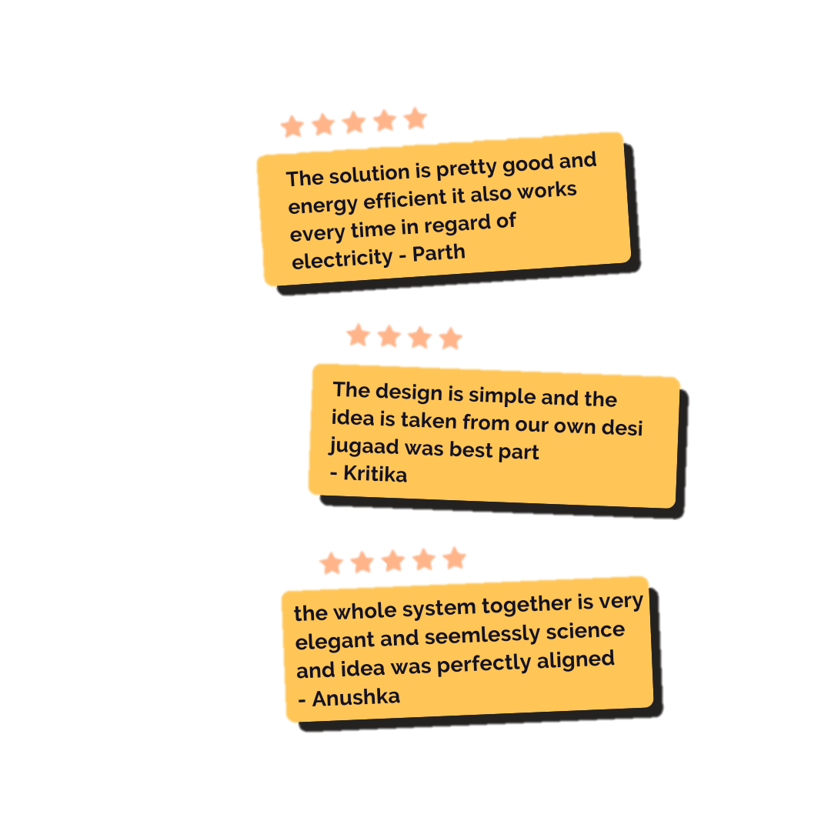
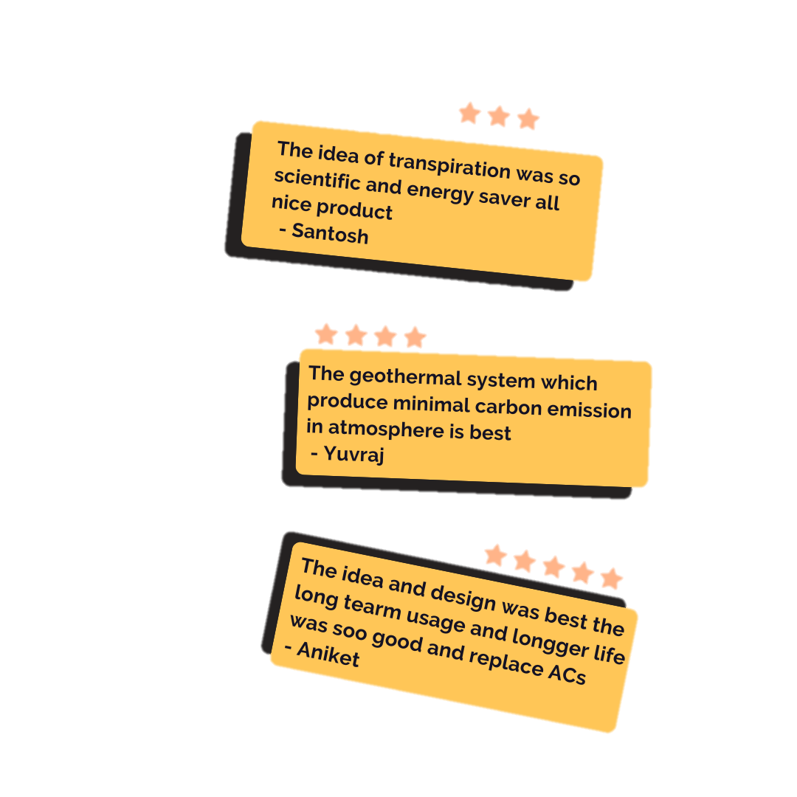
FEEDBACKS AND OUR TEAM
Lakshya Khare(lead)
TO GET CONNECTED DROP A MESSAGE ON:
MAIL: lakshyakhare226@gmail.com
PORTFOLIO: https://lakshya-khare.github.io/Portfolio/
LINKEDIN: www.linkedin.com/in/lakshyakhare
Team lead Lakshya oversees all aspects of our project during this phase. His leadership and vision drive our progress. With a keen eye for detail, he ensures that every piece falls into place seamlessly.
Janvi Jain:
Bivek Kumar Sharma:
Information compiler and coordinator, essential for organizing and coordinating team efforts, serving as the backbone of operations.
Research specialist and team glue, unmatched in research skills, diving deep into data to uncover insights that guide decisions and ensuring smooth collaboration within the team.
Inshu Jat:
Mayuri Bodade:
Solution and prototype architect, renowned for analytical mind and problem-solving skills, bridging the gap between theory and practical implementation through elegant solutions and prototypes.
Prototyping wizard, known for expertise in building prototypes, turning concepts into tangible designs with coding prowess and creativity.

Slide 12
THANKS!
This presentation is a part of the pitch submission for the IDS 4-Greenovation Challenge, which is being prepared and submitted by the first year CSE DS Branch students of TEAM PHOENIX from LNCT Group of Colleges in Bhopal.
Part Of Ending Cover Please Do Not Include This In Pitch

